Slide 1
Sales Insights - Data
Analysis Project using Tableau
By – ISHIKA SHARMA
h ps://github.com/ishikasharma 19/Sales-Insight-Project
l
1

Slide 2

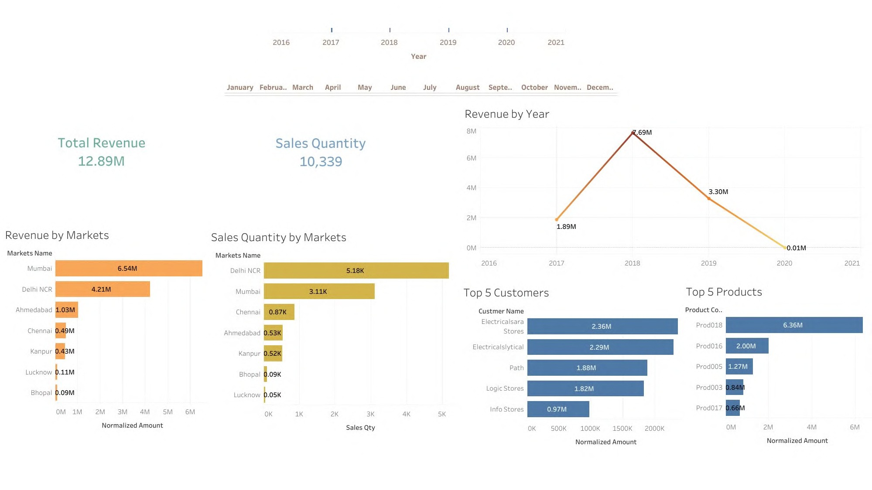

Slide 3
